Slide 1
CS 370 Introduction to Security
Software Security:
Buffer Overflow Vulnerability

Slide 2
Due Date
Please solve all tutorials and the NSA codebreaker Task 0, A1, A2, B1, and B2 before 12/9 11:59 am
NSA codebreaker finishes 12/09/22 11:59 am, that’s why.
There will be no later submission
I need to get your grade during 12/10~12/12

Slide 3
We will have Quiz 2 on 11/22
Quiz 2
Will be opened at 11/22 8:30 am
Ends at 11/28 11:59 pm
3 attempts
Takes the highest score
You can refer to any class materials during taking the quiz

Slide 4
Quiz 2 Coverage
SSL/TLS
Web Security (password and SQL injection)
Web Security (XSS and CSRF)
Something related to the codebreaker preps
Buffer overflow

Slide 5
Topic for Today
Software errors (vulnerabilities)
What are they?
How attackers exploits software vulnerabilities
To achieve their goal?
A notable software vulnerability
Buffer Overflow Attack
Common Vulnerabilities Exposures (CVE)

Slide 6

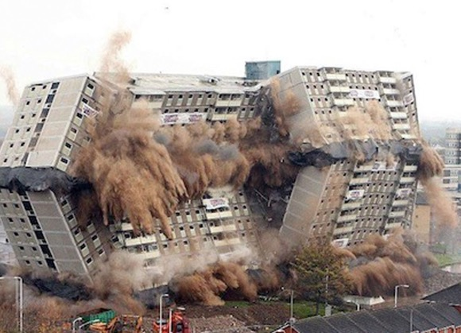
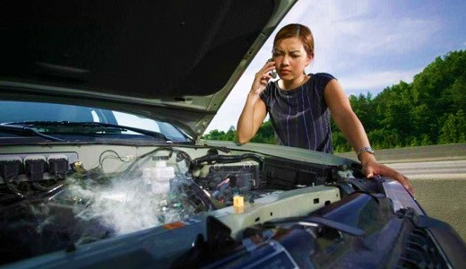
In Manufacturing Goods..
Humans are building the product
Humans are prone to errors especially if
Stressful
Worked too much hours
Production cycle due in 1 day

Slide 7

We Build Software
Developers are humans
Prone to errors
Make more mistakes if
They are too stressful from work
They are too stressful from life
Work is hard
Worked too much hours (60+ hrs/wk)
Speeding up development schedule due to
IMPORTANT PRODUCTION CYCLE

Slide 8
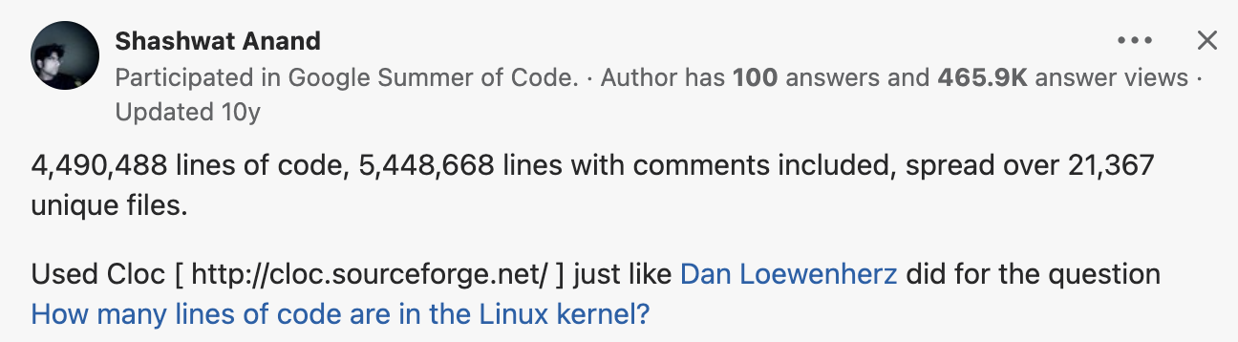
Modern Software is Complex
Google Chrome
+4M lines of pure code in 10 yrs ago

Slide 9
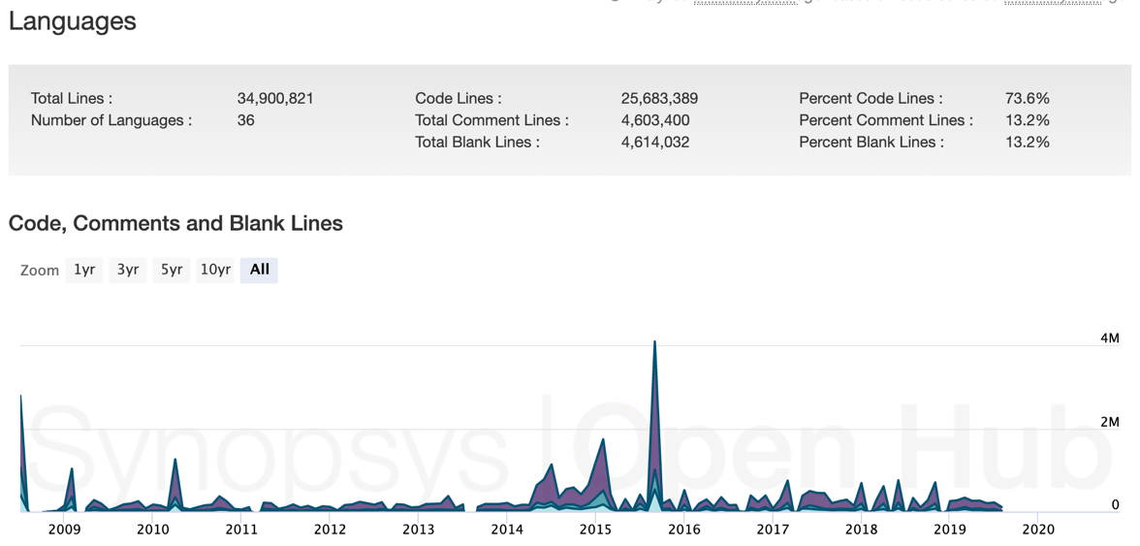
Modern Software is Complex
Google Chrome
>4M lines of pure code in 10 yrs ago
>34M lines these days..

Slide 10
Modern Software is Complex
Others
Linux kernel
>12M lines of code in 2015
>27M lines of code in 2020
Android
Android 1.6: >4.5M lines in 2009
Android 5.1: > 9M lines in 2014
Android 8.0: > 25M lines in 2017
Humans are prone to errors.
2. Work environment can make people to more prone to errors
3. The complexity in software makes humans more prone to errors..
Complexity: O(N²) where N = lines of code

Slide 11
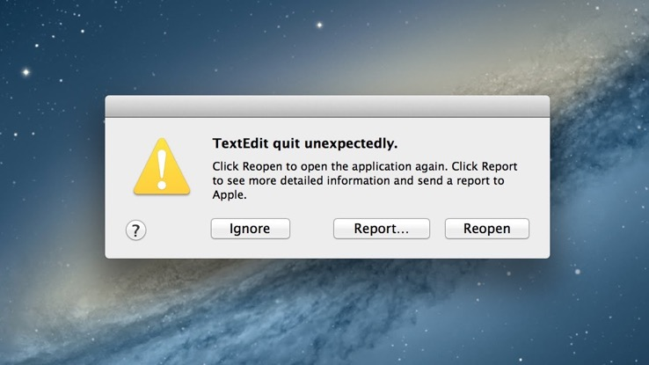
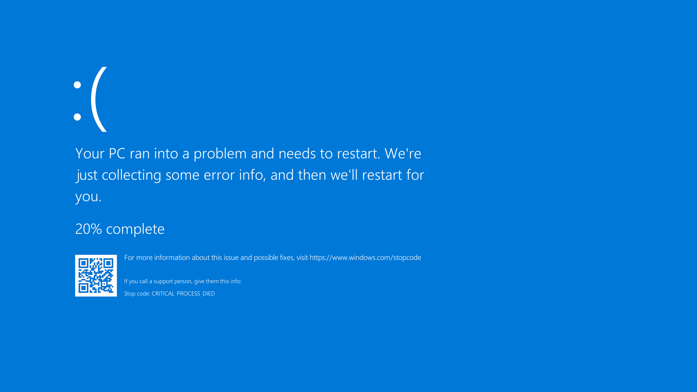
What Happens If We Made Mistake in Our Software?
Crash

Slide 12
What Happens If We Made Mistake in Our Software?
Crash

Slide 13


What Happens If We Made Mistake in Our Software?
A hack
1. Find an error
3. Get an
admin access
2. Build an exploit of that error
(tame the error to control the error to do something else)

Slide 14

What Happens If We Made Mistake in Our Software?
A hack
1. Find an error
3. Get an
admin access
4. Delete all files
2. Build an exploit of that error
(tame the error to control the error to do something else)

Slide 15
Reduce Mistakes
Write testcases and run test!
Code review
Put a non-stressful human here!
Reading code in a different perspective
-> may find new errors
Use tools to check errors
We will learn about these in the last week
But these are often ignored or
not practiced well in reality…

Slide 16
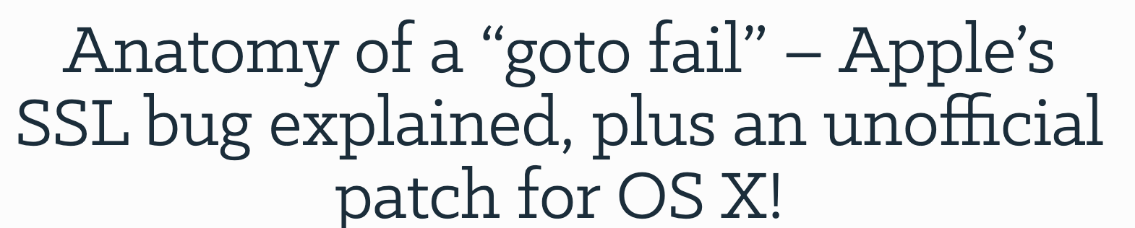
An Example: goto fail
In 2014

Slide 17
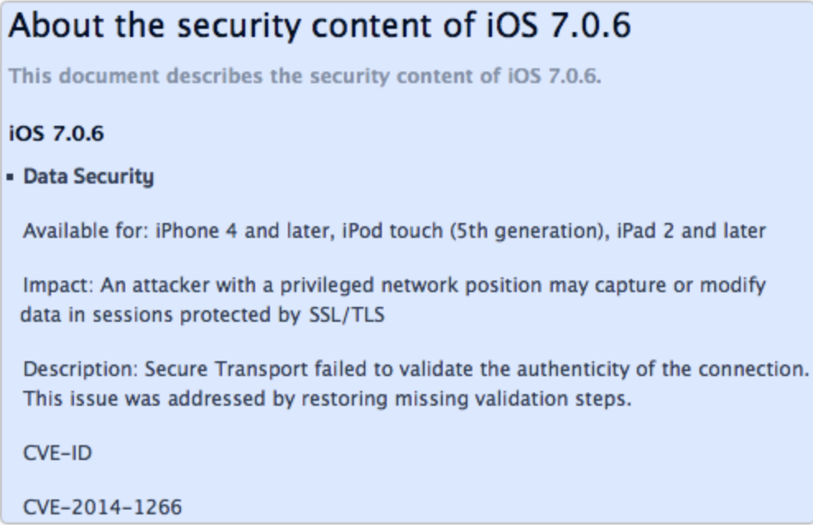
An Example: goto fail
In 2014
Why???
What was the mistake??

Slide 18
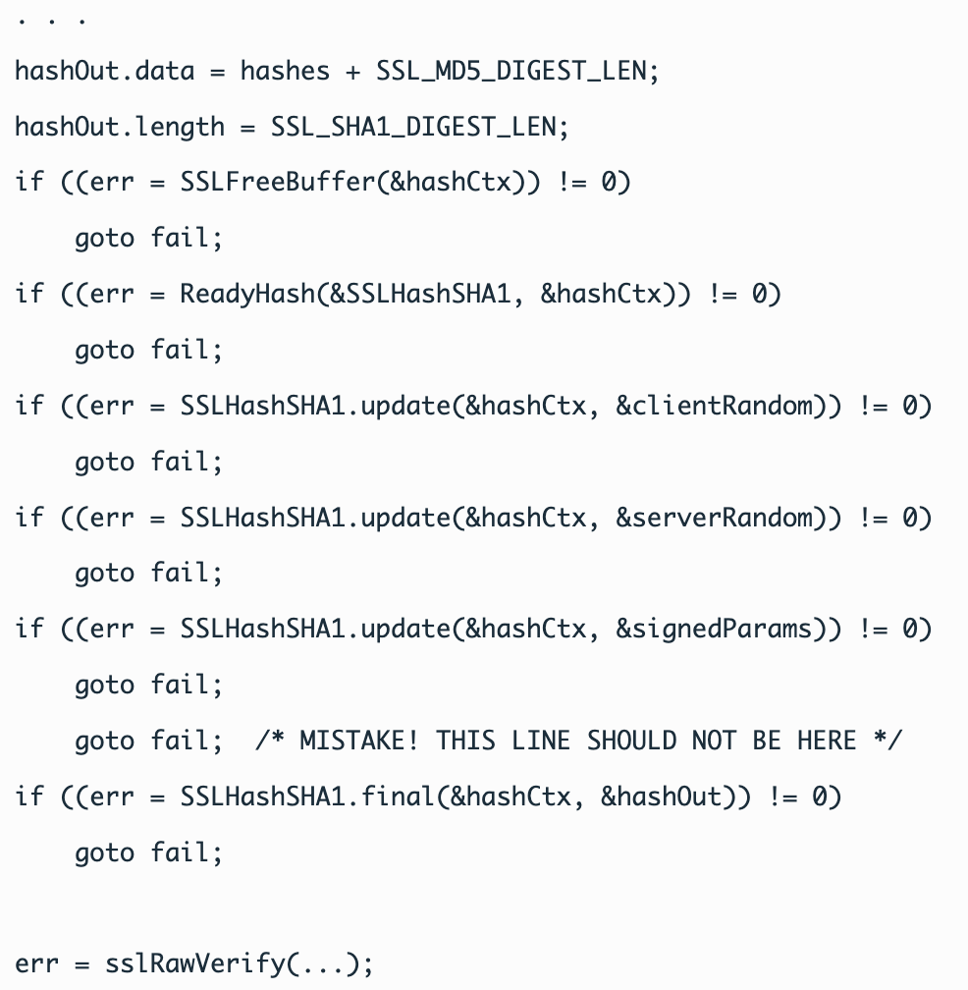
An Example: goto fail
Error checking code
If there are ‘errors’ in ‘err’
The code moves to fail;
The marked parts are OK
They run SHA1 and check errors

Slide 19
An Example: goto fail
The marked parts are OK
They run SHA1 and check errors

Slide 20
An Example: goto fail
What about this???
It does not guarded with any
If clause
It always runs
goto fail;
Skips the verification step…

Slide 21
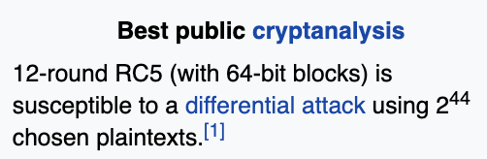
What an Attacker Can Do?
1. Suppose attacker operates a public Wi-Fi router
Name it as ‘Google Starbucks Wi-Fi’ near Starbucks
Or ‘Corvallis Free Public Wi-Fi’
Then many people will connect to it to use a free Internet
2. Attacker sends a fabricated TLS packet
To choose specific cryptographic protocol (SHA1) is used
Trigger goto fail;
Force browser to use weak encryption algorithm
3. Attacker can pretend themselves as google.com
By breaking weak algorithm with known attacks

Slide 22
Small Mistake, Big Impact
A mistake: adds one additional line of ‘goto fail;’
Result: Attackers may hijack a TLS protected connection
Impact: Attackers may read/modify all TLS connections from iOS/MacOS
Implications
Even a simple mistake could be a disaster
Errors are not arbitrarily happening; not like natural disaster
If so, it just crash indefinitely
Errors are controlled by attackers
Errors can be ‘exploited’ by attackers
They can achieve their goals

Slide 23
The Most Popular Vulnerability Class
Buffer Overflow Vulnerability
A bug that happens if the program put more data than a buffer size
E.g.
char buf[16];
strcpy(buf, “CS370 is a very fun class. You must take it”);
2nd argument is definitely longer than 16 bytes

Slide 24
Buffer Overflow
A vulnerability that the program puts more data than a buffer can hold
Buffer Overflow can destroy a system’s data structure
Program stack
An attacker can run any kind of code existing in the system
delete_all()
system(“rm –rf /”);

Slide 25
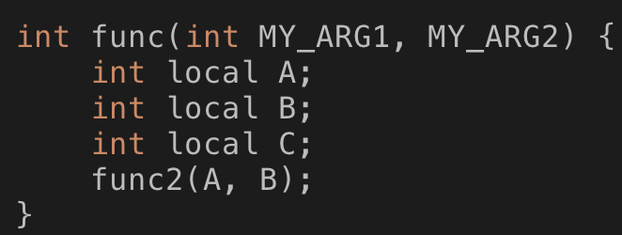
Program Stack (Grows Downward)
MY_ARG2
MY_ARG1
Return Addr
Saved EBP
%ebp
Starts at %ebp (bottom), ends at %esp (top)
Defines a variable scope of a function
Local variables (negative index over ebp)
Arguments (positive index over ebp)
Function call arguments (positive index over esp)
Maintains nested function calls
Return target (return address)
Local variables of the upper level function (Saved ebp)
Local A
ebp-c
Local B
ebp-10
Local C
ebp-14
ARG 2
esp+4
%esp
ARG 1
esp

Slide 26
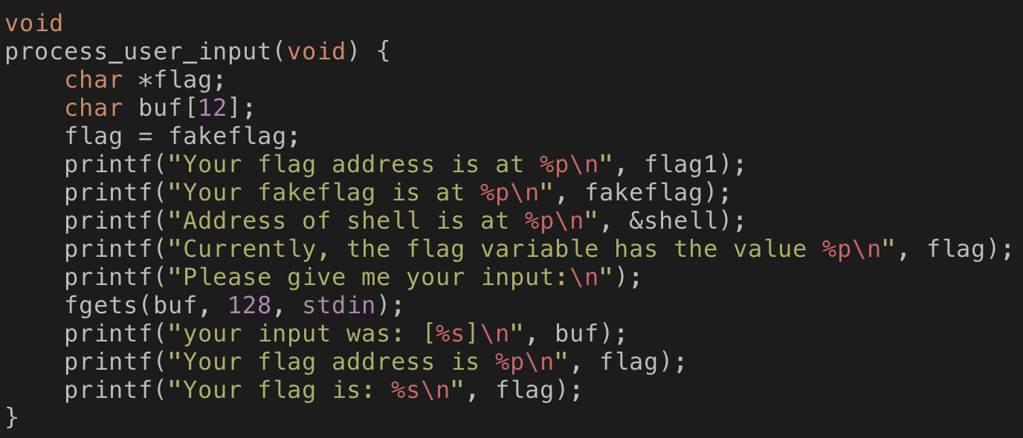
Target Program
bof.c
Objective 1: read flag1

Slide 27
Target Program
bof.c
Objective 1: read flag1
Buffer size: 12
Input size: upto 128 bytes
Can you make flag to point
flag1
Not fakeflag??

Slide 28
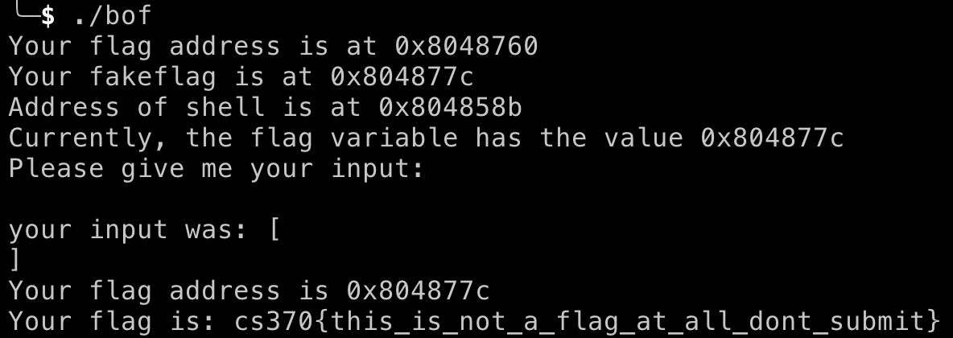
Target Program
Address information
Fakeflag is at 0x804877c
Flag is at 0x8048760

Slide 29
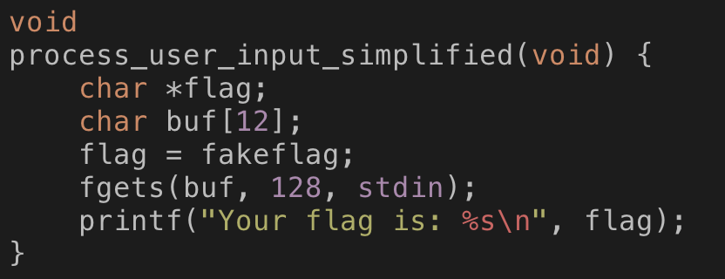
Program Stack
No ARGS (void)
No ARGS (void)
Return Addr
Saved EBP
%ebp
Code & Stack
Flag = fakeflag
ebp-c
buf[8..12]
ebp-10
buf[4..8]
ebp-14
buf[0..4]
ebp-18
ARG 3 (stdin)
esp+8
ARG 2 (128)
esp+4
%esp
ARG 1 (buf)
esp

Slide 30
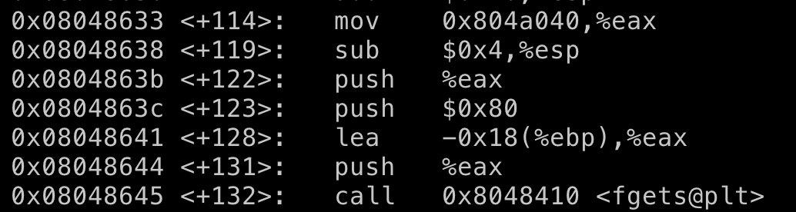
Program Stack
No ARGS (void)
No ARGS (void)
Return Addr
Saved EBP
%ebp
Code & Stack
Flag = fakeflag
ebp-c
buf[8..12]
ebp-10
buf[4..8]
ebp-14
buf[0..4]
ebp-18
Push stdin
Push 128 == 0x80
ARG 3 (stdin)
esp+8
Push buf = ebp-0x18
ARG 2 (128)
esp+4
%esp
ARG 1 (buf)
esp

Slide 31
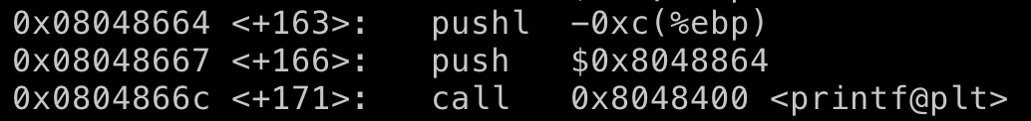
Program Stack
No ARGS (void)
No ARGS (void)
Return Addr
Saved EBP
%ebp
Code & Stack
Flag = fakeflag
ebp-c
buf[8..12]
ebp-10
buf[4..8]
ebp-14
buf[0..4]
ebp-18
Push flag
esp+8
ARG 2 (flag)
esp+4
%esp
ARG 1 (string)
esp

Slide 32
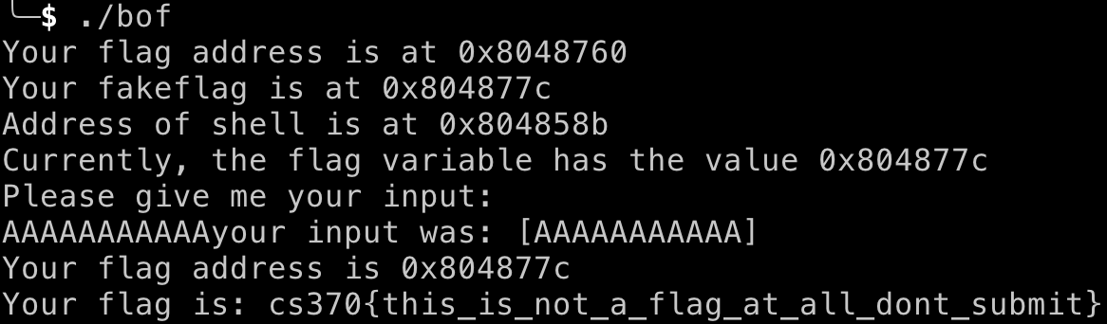
What if you type 11 bytes of ‘A’s and ‘\x00’?
No ARGS (void)
No ARGS (void)
Return Addr
Saved EBP
%ebp
If I type “A”*11, then fgets attach ’\x00’ at the end
Flag = 0x804877c
ebp-c
buf[8..12]
ebp-10
buf[4..8]
ebp-14
buf[0..4]
ebp-18
esp+8
ARG 2 (flag)
esp+4
%esp
ARG 1 (string)
esp

Slide 33
What if you type 11 bytes of ‘A’s and ‘\x00’?
No ARGS (void)
No ARGS (void)
Return Addr
Saved EBP
%ebp
If I type “A”*11, then fgets attach ’\x00’ at the end
Flag = 0x804877c
ebp-c
AAA\x00
ebp-10
AAAA
ebp-14
AAAA
ebp-18
esp+8
ARG 2 (flag)
esp+4
%esp
ARG 1 (string)
esp

Slide 34
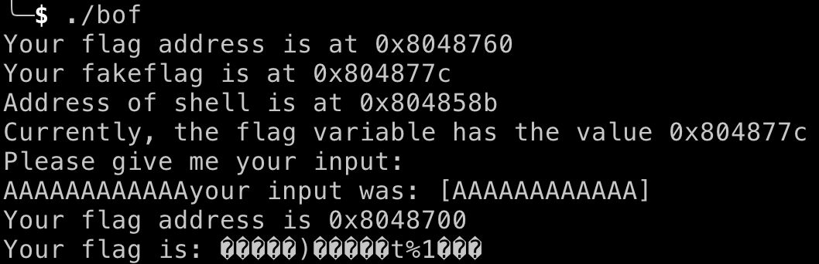
What if you type 12 bytes of ‘A’s and ‘\x00’?
No ARGS (void)
No ARGS (void)
Return Addr
Saved EBP
%ebp
If I type “A”*12, then fgets attach ’\x00’ at the end
Flag = 0x804877c
ebp-c
AAAA
ebp-10
AAAA
ebp-14
AAAA
ebp-18
esp+8
ARG 2 (flag)
esp+4
%esp
ARG 1 (string)
esp

Slide 35
What if you type 12 bytes of ‘A’s and ‘\x00’?
No ARGS (void)
No ARGS (void)
Return Addr
Saved EBP
%ebp
If I type “A”*12, then fgets attach ’\x00’ at the end
Flag = 0x8048700
ebp-c
AAAA
ebp-10
AAAA
ebp-14
AAAA
ebp-18
Local variables are adjacent each other.
if we can overflow the buf variable, then we can change
the flag variable as we wish!!!
esp+8
ARG 2 (flag)
esp+4
%esp
ARG 1 (string)
esp

Slide 36
What if you type 12 bytes of ‘A’s and ‘\x00’?
No ARGS (void)
No ARGS (void)
Return Addr
Saved EBP
%ebp
If I type “A”*12 and then
Put \x60\x87\x04\x08 (0x8048760)
Intel processors are using Little Endian, so that’s why
0x41424344 = 0x44 0x43 0x42 0x41
Flag = 0x804877c
ebp-c
AAAA
ebp-10
AAAA
ebp-14
AAAA
ebp-18
esp+8
ARG 2 (flag)
esp+4
%esp
ARG 1 (string)
esp

Slide 37
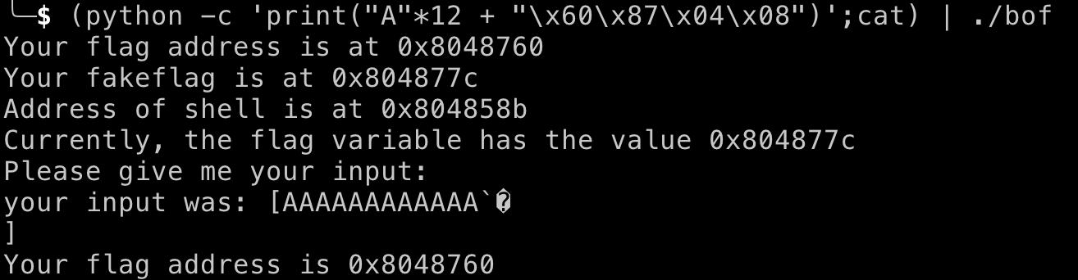
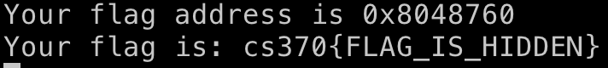

What if you type 12 bytes of ‘A’s and ‘\x00’?
No ARGS (void)
No ARGS (void)
Return Addr
Saved EBP
%ebp
If I type “A”*12 and then
Put \x60\x87\x04\x08 (0x8048760)
Intel processors are using Little Endian, so that’s why
0x41424344 = 0x44 0x43 0x42 0x41
Flag = 0x8048760
ebp-c
AAAA
ebp-10
AAAA
ebp-14
AAAA
ebp-18
esp+8
ARG 2 (flag)
esp+4
And it will print the flag!!!
%esp
ARG 1 (string)
esp

Slide 38
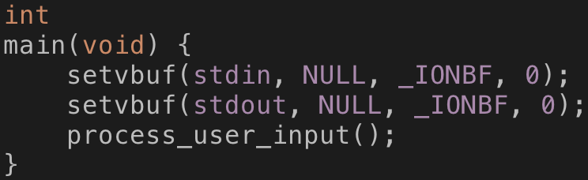
Buffer Overflow is More Powerful Than Just Changing Variable Value
Program stack is used for matching call/return pairs
main() calls process_user_input()
process_user_input() runs
The execution must return to the point in main
right after running process_user_input
main() continues…
How the program knows this??

Slide 39

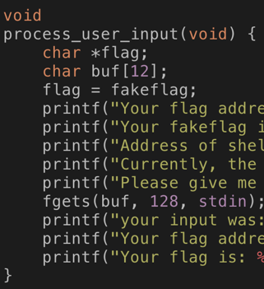
Return Address Stored in the Stack
No ARGS (void)
No ARGS (void)
Return Addr
Saved EBP
%ebp
We store the return address when
Making a function call!!
Flag = 0x804877c
ebp-c
AAAA
ebp-10
AAAA
ebp-14
AAAA
ebp-18
esp+8
ARG 2 (flag)
esp+4
%esp
ARG 1 (string)
esp

Slide 40
Return Address Stored in the Stack
No ARGS (void)
No ARGS (void)
Return Addr
Saved EBP
%ebp
When returning from process_user_input
Flag = 0x804877c
ebp-c
AAAA
ebp-10
AAAA
ebp-14
AAAA
ebp-18
esp+8
ARG 2 (flag)
esp+4
%esp
ARG 1 (string)
esp

Slide 41
What We Can Do with Buffer Overflow?
No ARGS (void)
No ARGS (void)
Return Addr
Saved EBP
%ebp
We can fill the data starting from a buffer
Flag = 0x804877c
ebp-c
AAAA
ebp-10
12 As
AAAA
ebp-14
AAAA
ebp-18
esp+8
ARG 2 (flag)
esp+4
%esp
ARG 1 (string)
esp

Slide 42
What We Can Do with Buffer Overflow?
No ARGS (void)
No ARGS (void)
Return Addr
Saved EBP
%ebp
We can fill the data starting from a buffer
Flag = 0x8048760
ebp-c
0x8048760
AAAA
ebp-10
12 As
AAAA
ebp-14
AAAA
ebp-18
esp+8
ARG 2 (flag)
esp+4
%esp
ARG 1 (string)
esp

Slide 43
What We Can Do with Buffer Overflow?
No ARGS (void)
No ARGS (void)
Return Addr
Saved EBP
%ebp
We can fill the data starting from a buffer
12 more As
Flag = 0x8048760
ebp-c
0x8048760
AAAA
ebp-10
12 As
AAAA
ebp-14
AAAA
ebp-18
esp+8
ARG 2 (flag)
esp+4
%esp
ARG 1 (string)
esp

Slide 44
What We Can Do with Buffer Overflow?
No ARGS (void)
No ARGS (void)
Put 0x12345678
Return Addr
Saved EBP
%ebp
We can fill the data starting from a buffer
12 more As
Flag = 0x8048760
ebp-c
0x8048760
AAAA
ebp-10
12 As
AAAA
ebp-14
AAAA
ebp-18
esp+8
ARG 2 (flag)
esp+4
%esp
ARG 1 (string)
esp

Slide 45
What We Can Do with Buffer Overflow?
No ARGS (void)
No ARGS (void)
Put 0x12345678
0x12345678
Saved EBP
%ebp
We can fill the data starting from a buffer
12 more As
Flag = 0x8048760
ebp-c
0x8048760
AAAA
ebp-10
12 As
AAAA
ebp-14
AAAA
ebp-18
Seems we can change the return address.
This allows us to make the program return to arbitrary address.
Let’s run a weird function!!!
esp+8
ARG 2 (flag)
esp+4
%esp
ARG 1 (string)
esp

Slide 46
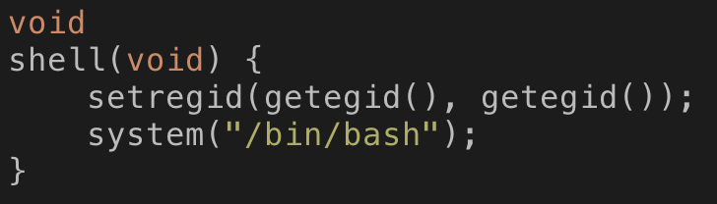
In bof.c
There is a shell() function
If we run this, it will
Inherit the challenge privilege (setregid())
Run “/bin/bash” (you can run any command with that privilege)
You might want to run ‘cat flag’
It has full privilege so you can read the flag…
If you run that, you indeed accomplish a privilege escalation and arbitrary code execution

Slide 47
How?
Get the function address
Shell() is at 0x804858b
Let’s overflow the buffer

Slide 48
What We Can Do with Buffer Overflow?
No ARGS (void)
No ARGS (void)
Put 0x804858b
Return Addr
Saved EBP
AAAA
%ebp
We can fill the data starting from a buffer
12 more As
AAAA
AAAA
Flag = 0x8048760
ebp-c
0x8048760
AAAA
ebp-10
12 As
AAAA
ebp-14
AAAA
ebp-18
esp+8
ARG 2 (flag)
esp+4
%esp
ARG 1 (string)
esp

Slide 49
What We Can Do with Buffer Overflow?
No ARGS (void)
No ARGS (void)
Put 0x804858b
0x804858b
Saved EBP
AAAA
%ebp
We can fill the data starting from a buffer
12 more As
AAAA
AAAA
Flag = 0x8048760
ebp-c
0x8048760
AAAA
ebp-10
12 As
AAAA
ebp-14
AAAA
ebp-18
esp+8
ARG 2 (flag)
esp+4
%esp
ARG 1 (string)
esp

Slide 50
What We Can Do with Buffer Overflow?
No ARGS (void)
No ARGS (void)
Put 0x804858b
0x804858b
Saved EBP
AAAA
%ebp
We can fill the data starting from a buffer
12 more As
AAAA
AAAA
Flag = 0x8048760
ebp-c
0x8048760
AAAA
ebp-10
12 As
AAAA
ebp-14
AAAA
ebp-18
esp+8
ARG 2 (flag)
esp+4
%esp
ARG 1 (string)
esp

Slide 51
Return Address Stored in the Stack
No ARGS (void)
No ARGS (void)
Return Addr
Saved EBP
%ebp
When returning from process_user_input
Flag = 0x804877c
ebp-c
AAAA
ebp-10
AAAA
ebp-14
AAAA
ebp-18
esp+8
ARG 2 (flag)
esp+4
%esp
ARG 1 (string)
esp

Slide 52
What We Can Do with Buffer Overflow?
No ARGS (void)
No ARGS (void)
Put 0x804858b
0x804858b
Saved EBP
AAAA
%ebp
We can fill the data starting from a buffer
12 more As
AAAA
AAAA
Flag = 0x8048760
ebp-c
0x8048760
AAAA
ebp-10
12 As
AAAA
ebp-14
AAAA
ebp-18
esp+8
ARG 2 (flag)
esp+4
%esp
ARG 1 (string)
esp

Slide 53
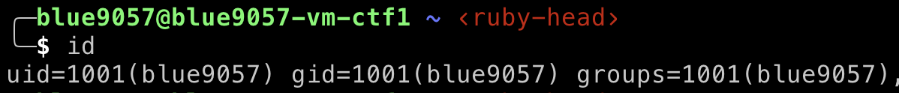
Result
Without exploitation
After exploitation
You will have gid = 40001 (week4-40001-solved)

Slide 54
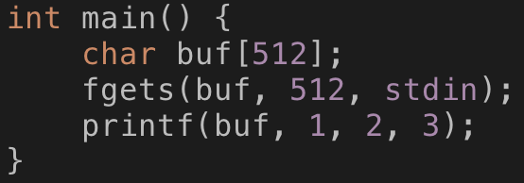
Many other vulnerabilities…
Format String Vulnerability
A bug that happens if the program makes mistake in using printf-like functions
E.g.,
char buf[512];
fgets(buf, 512, stdin);
printf(buf, 1, 2, 3);
What if your buffer contains “%d %x %p”
printf(”%d %x %p\n”, 1, 2, 3);
It will print out
1 2 0x3

Slide 55
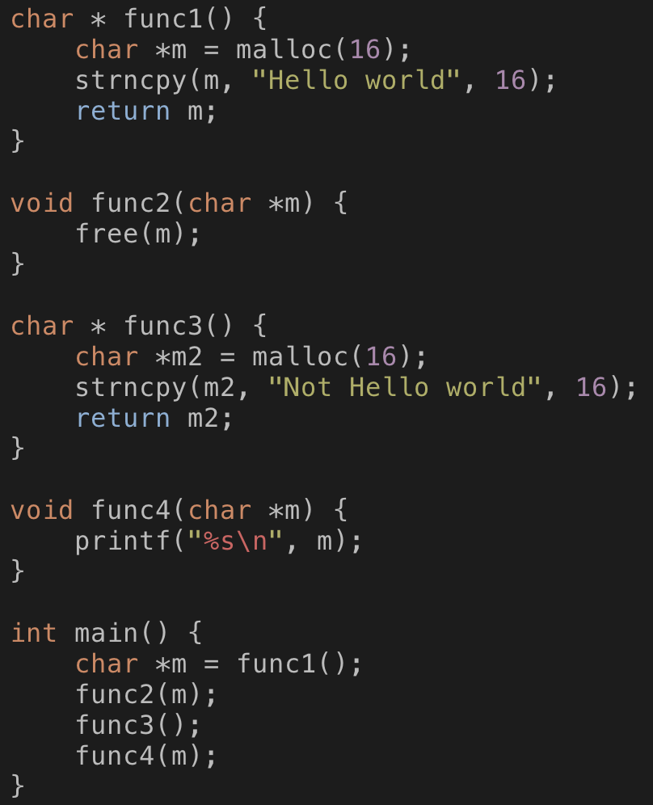
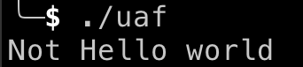
Many other vulnerabilities…
Use-after-free vulnerability
You allocate memory in func1()
Char *m = malloc(16), put Hello, world
You free that block in func2(m)
free(m)
You allocate memory in func3()
Char *m2 = malloc(16), put Not hello, world
You use m in func4

Slide 56

Vulnerabilities are Critical But We Can’t Avoid Vulnerabilities
Theoretical limit
We cannot generally tell if a program has a vulnerability or not
Reduces to the same problem as ‘Halting Problem’
Alan Turing have set the bar:
There could be no algorithm that can tell a program stops or not
There could be no algorithm that can tell a program as a vulnerability or not
What we can do?
Create patterns of existing vulnerabilities and find that
Run the program and find any crashes/vulnerabilities

Slide 57
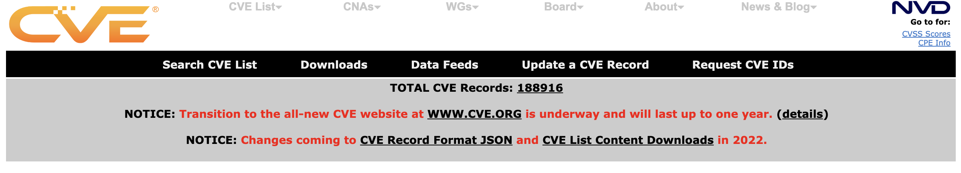
Common Vulnerabilities and Exposures (CVE)
Because the impact of software vulnerabilities are huge, we archive and announce common vulnerabilities to the community
Maintained by NIST/MITRE

Slide 58
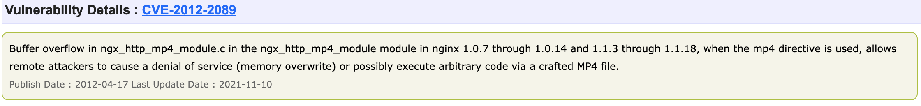
How CVE Works?
Developers
Find vulnerabilities in their software (e.g., nginx v1.0.7 ~ 1.0.14 has a BOF)
Fix that
Announce that to CVE
System operators
Watch the CVE list and update vulnerable softwares

Slide 59
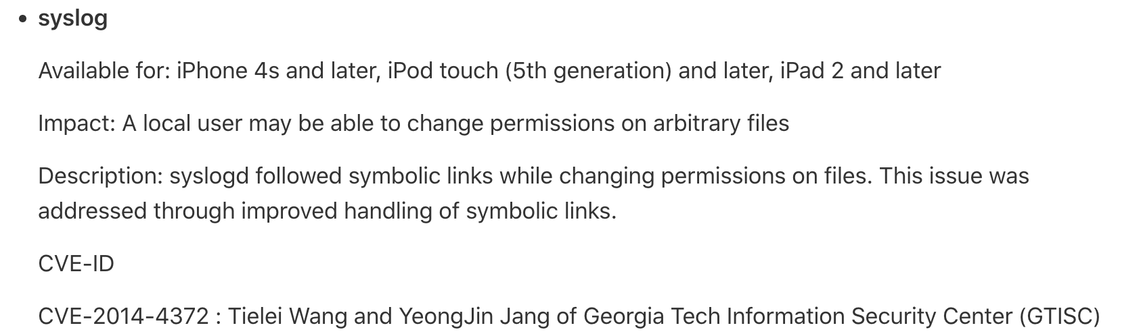
How CVE Works
White Hat Hackers
Analyze software using testing methods
Fuzzing, symbolic execution, manual testing, code auditing, reverse engineering, etc
Find a bug
Exploit the bug
Vendor reports that to NIST/MITRE CVE

Slide 60
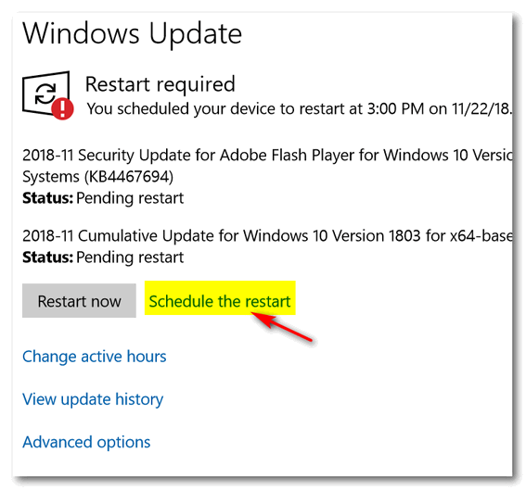
Patch Tuesday
Software vulnerabilities are reported every day
We cannot fix all the vulnerabilities at once
Fix also requires testing
Developers set patch schedule
Microsoft Windows regularly issues patch on
Every 2nd Tuesday
Don’t miss the update
That gives a lot of opportunities to hackers

